Slide 1
Augie Transaction Dataset
Data 490 - Senior Inquiry
Ryan Benac

Slide 2
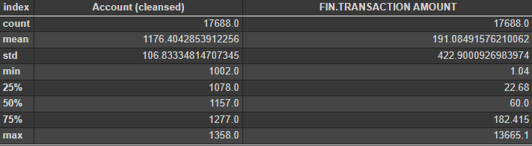
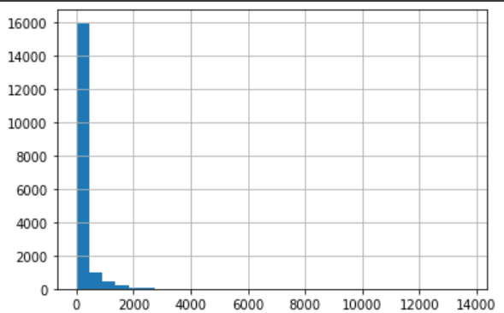
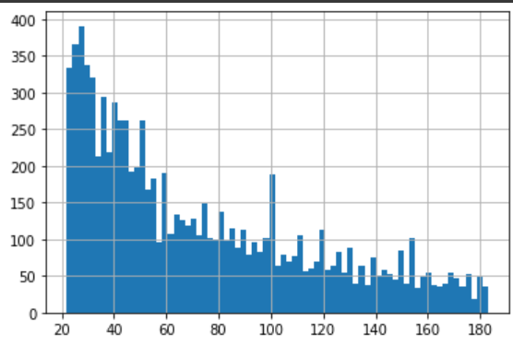
What is Normal?
Number of Transactions
Transaction Amount
Transaction Amount

Slide 3
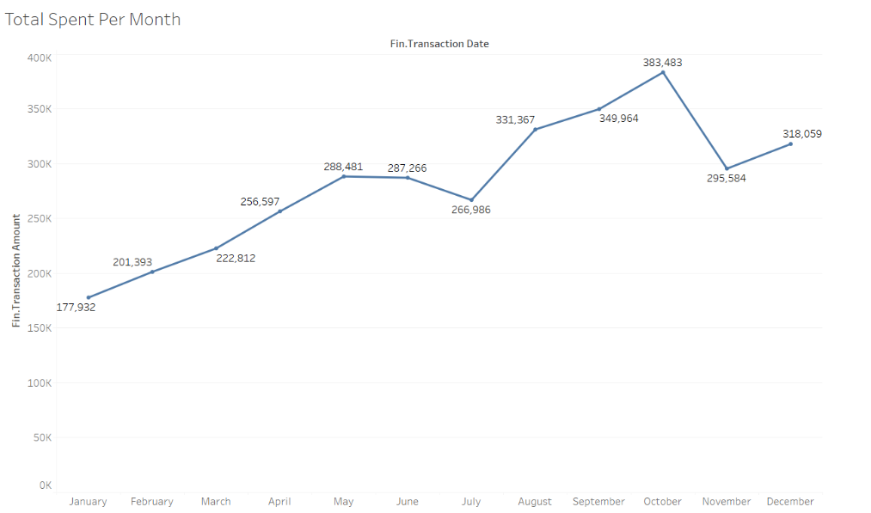

Slide 4
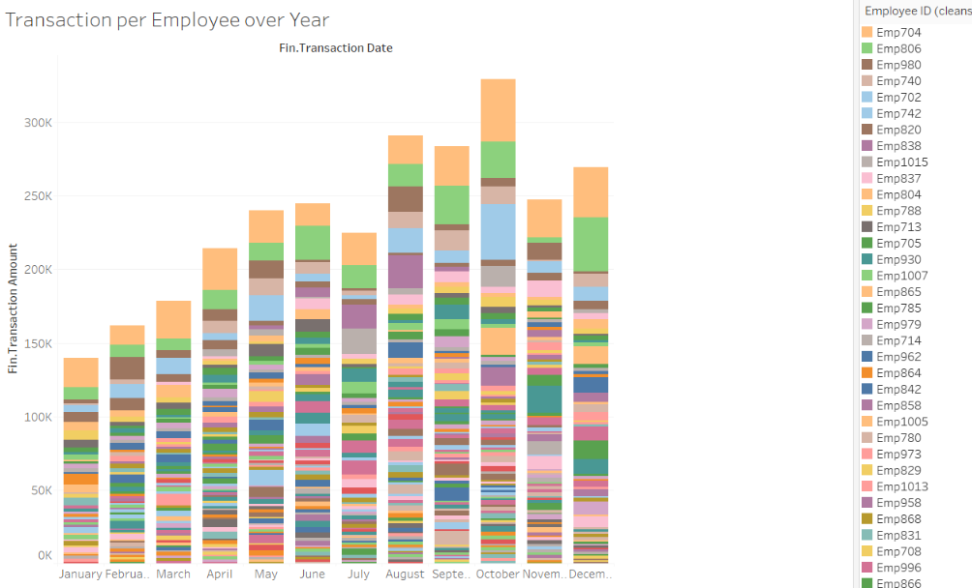
Visualizations and EDA

Slide 5
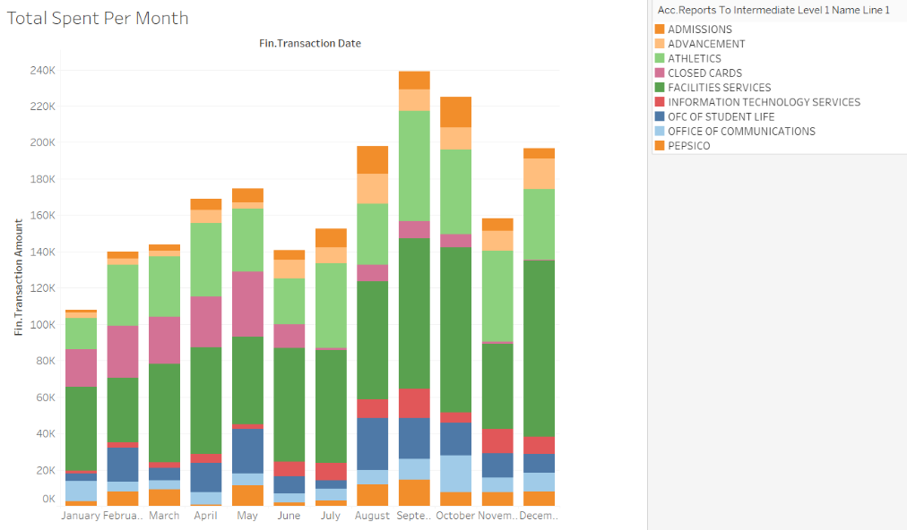

Slide 6
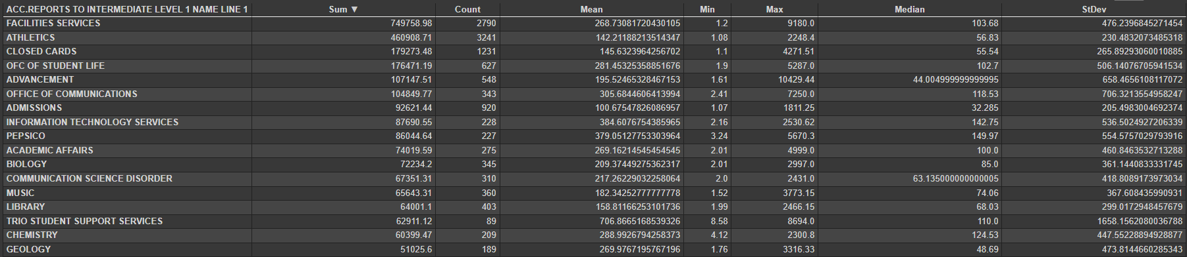
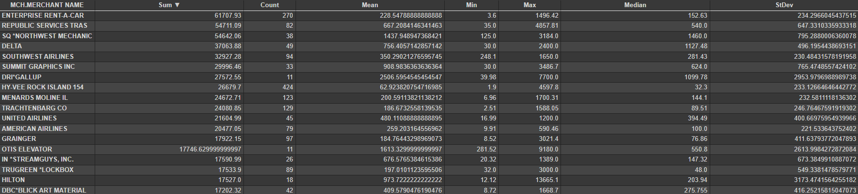
Most Spent by Department
Most Spent by Merchant

Slide 7
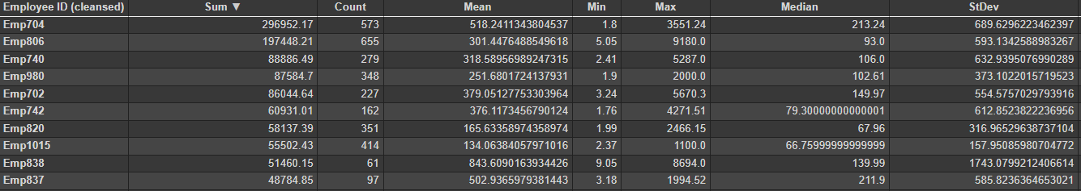
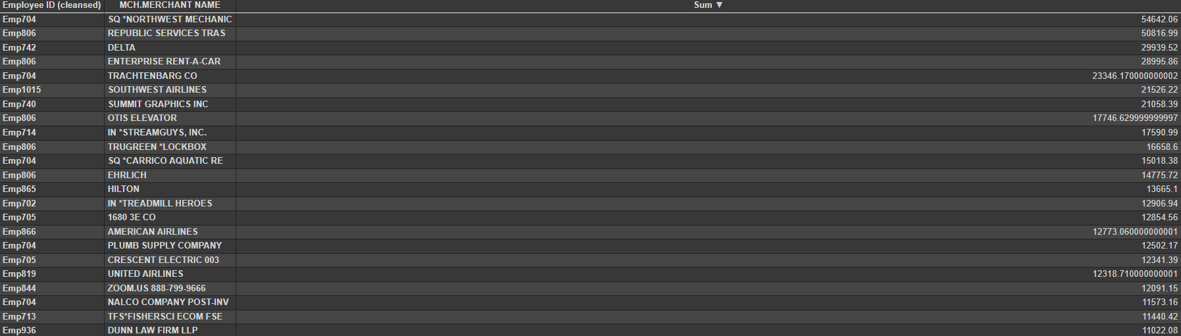
Most Spent by Employee
Most Spent by Employee to Merchant

Slide 8
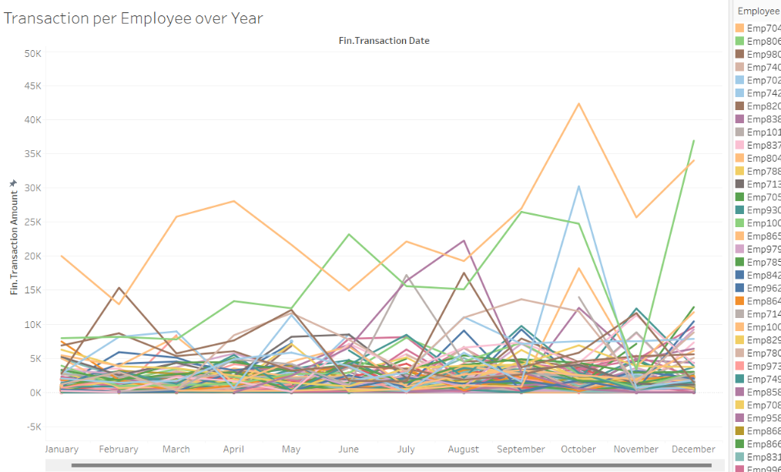

Slide 9
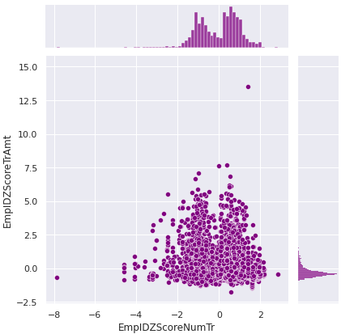
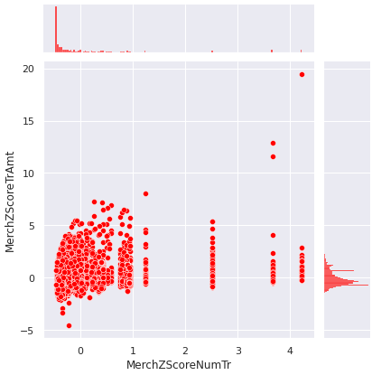
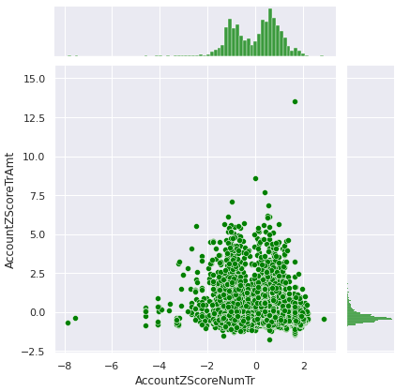
Rules (Z-Score Graphing)
Employee ID (cleansed)
MCH.MERCHANT NAME
Account (cleansed)

Slide 10
Abnormality Results
Classify Method | Normal | Abnormal
Employee ID Z-Score | 17178 | 473
Merchant Z-Score | 16683 | 968
Account Z-Score | 17183 | 468
Isolation Forest | 14117 | 3534

Slide 11
Grouping Results
Decision | Abnormal
All Z-score marked | 55
All Z-score + Isolation marked | 54
2 of 3 Z-score marked | 460
2 of 3 Z-score + Isolation marked | 410
At least 1 Z-score | 1395
Isolation Forest | 3534

Slide 12
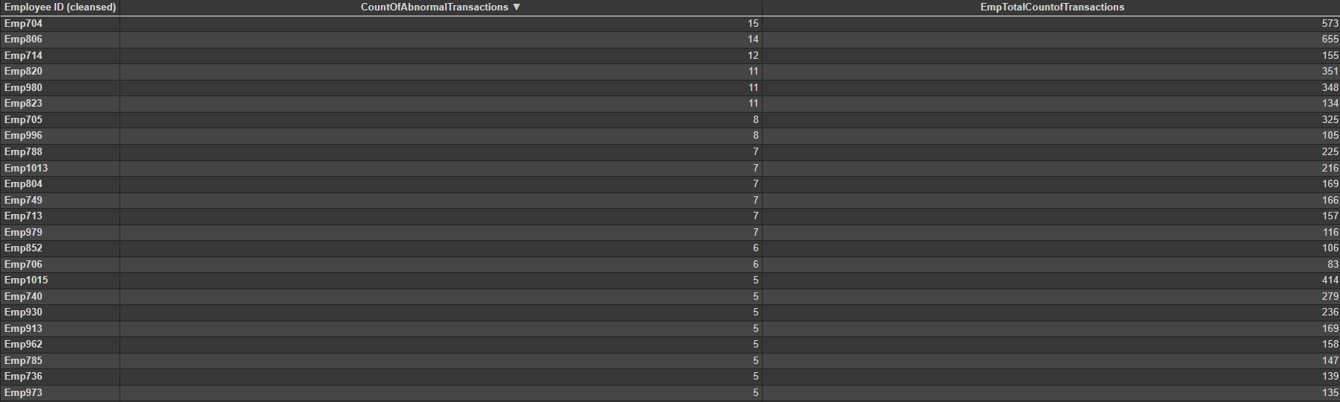
Which employee had the most abnormal transactions?

Slide 13
Data Cleaning
Model Choice
Remove negatives
Check duplicate values
Choose columns
Abnormal = 1 and Normal = 0
Fix data types
Logistic regression
Random Forest

Slide 14
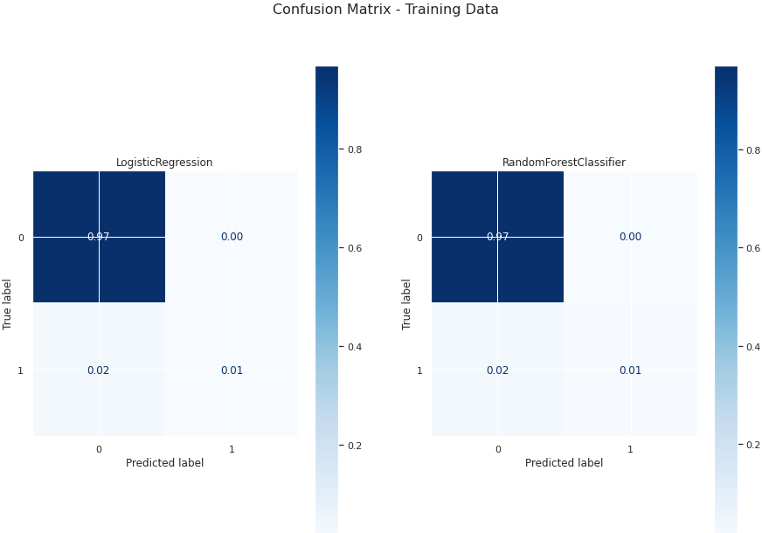
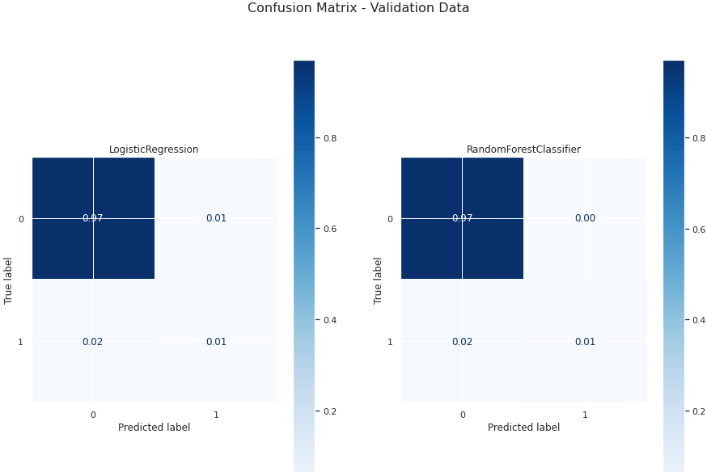
Results

Slide 15
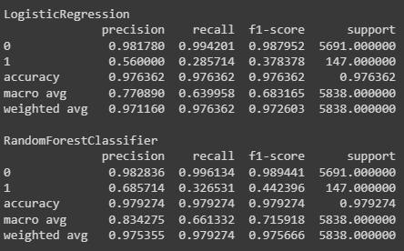

Outcomes

